Slide 1
Teaching Electricity
Ohio Energy Project
7th and 9th grade
Professional Development

Slide 2
Goals of Session
Build a series, parallel and short circuit.
Understand the basic components of an electric circuit.
Build a circuit to complete a given task.
Use electronic symbols to describe and write out a circuit.
Use a meter to measure volts, current, and resistance in a circuit.
Demonstrate ways energy can be transferred in an electric circuit (sound, light, heat, mechanical energy).

Slide 3
Pre-test
What do you know?

Slide 4
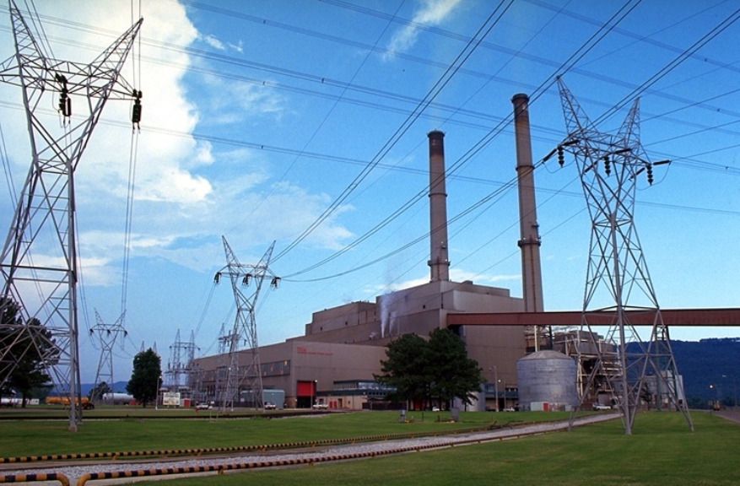
What is Electricity?
https://www.studentenergy.org/topics/electricity
This is a 3:10 video from www.studentenergy.org

Slide 5
Coal Sequence Activity
Place cards in proper
sequence of events.

Slide 6
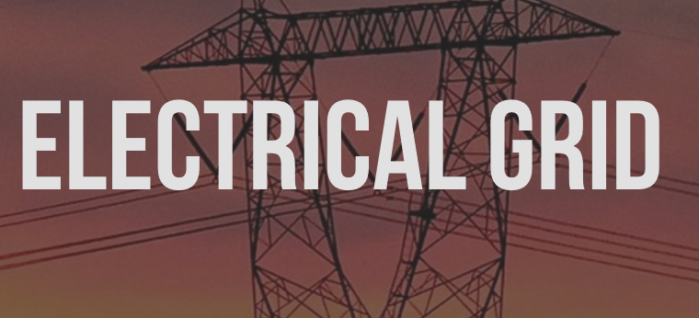
Coal Sequence Where Does your Electricity Come From?
For more detailed information, follow up with the student energy 3:11 video
https://www.studentenergy.org/topics/electrical-grid

Slide 7
Circuits are Everywhere Understanding the Mechanics of Solar Technology
This lesson was written for Ohio Sea Grant by Lyndsey Manzo.
It was developed for a Solar Education Workshop presented
at OSU’s Stone Lab in June 2106. All lessons are available at:
go.osu.edu/teachers
Copies are also can be found at the OEP website:
www.ohioenergy.org

Slide 8
Circuits Exploration – Background Information
Electricity is a secondary energy source. A primary source must be
transformed to electrical energy.
Electricity produced at power plants is alternating current using a generator.
Advantage: AC can travel long distances with minimal loss of energy
Transformers are used to increase or decrease the voltage
(electrical pressure).
Chemical energy is be transformed to electrical energy in a battery –
Direct Current.
Two different metals are used in a chemical solution.
The reaction at the anode end gives up electrons and the reaction at
the cathode end absorbs them.
This is a direct current since the electrons only flow in one direction.
Advantage: Portable

Slide 9
Why do electrons flow in a circuit?
Electrical potential energy
Potential energy is stored energy that an object has due to its position or shape.
An electric charge has potential energy because of its position in an electric field.
For example, when two negative charges are close together, they have potential
energy because they repel each other and have the potential to push apart.
If the charges move apart, their potential energy decreases.
Electric charges always move spontaneously from a position where they have
higher potential energy to a position where their potential energy is lower.

Slide 10
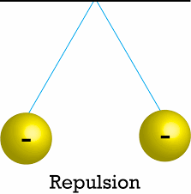
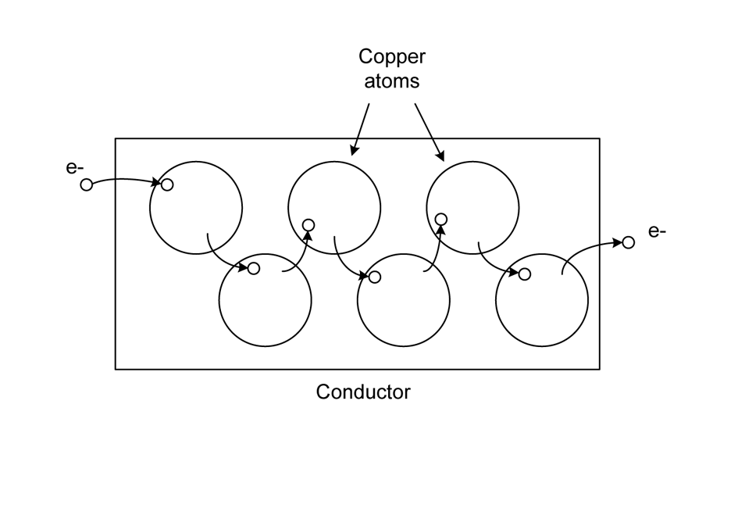

Slide 11
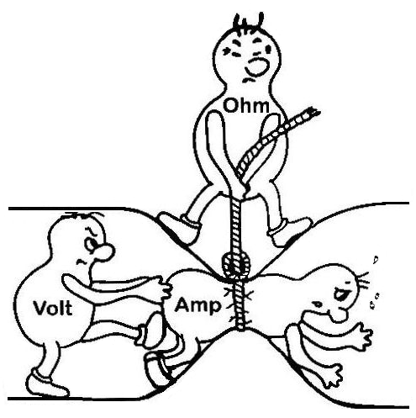
Electrical Relationships
I x R = V
Amperage X Resistance = Voltage

Slide 12
Building Tips for Snap Circuits
The “wires” are embedded in the blue wire blocks of different lengths.
2. Each block has a different function and label. For example,
the green slide switch is marked on the diagram.
3. A clear plastic grid, labeled 1 - 10 and A - G, is to help space
components are wires. It functions as a printed circuit board.

Slide 13
Building Tips for Snap Circuits, continued
4. Next to each part in every circuit drawing is a
small number in black. This tells you which level
the component is placed.
Place all parts on level 1 first, then the
parts on level 2, then the parts on level 3, etc.
5. Some components have a + and a – side
or terminal. The motor is an example.

Slide 14
Each lesson was designed to:
have students build the circuit.
understand what is happening within the circuit.
hypothesize and test changes in a circuit.
troubleshoot as to why it does or doesn’t work.

Slide 15
Lesson 1 Circuits Exploration
Students will build series circuits. Parts include a switch,
light, motor and battery.
Students will build parallel circuits.
Series and Parallel circuits can be combined.
.

Slide 16
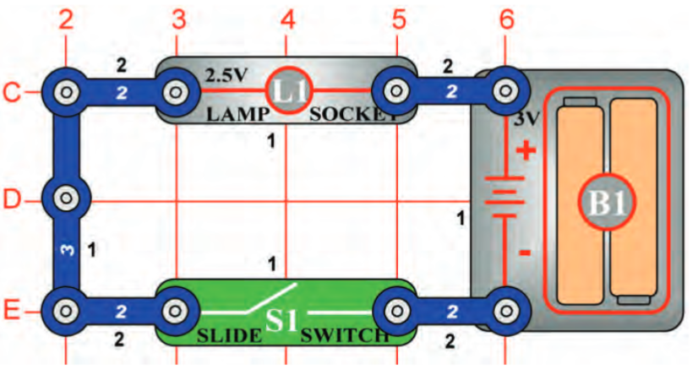
Complete questions after building Project 1
Build
Project 1

Slide 17
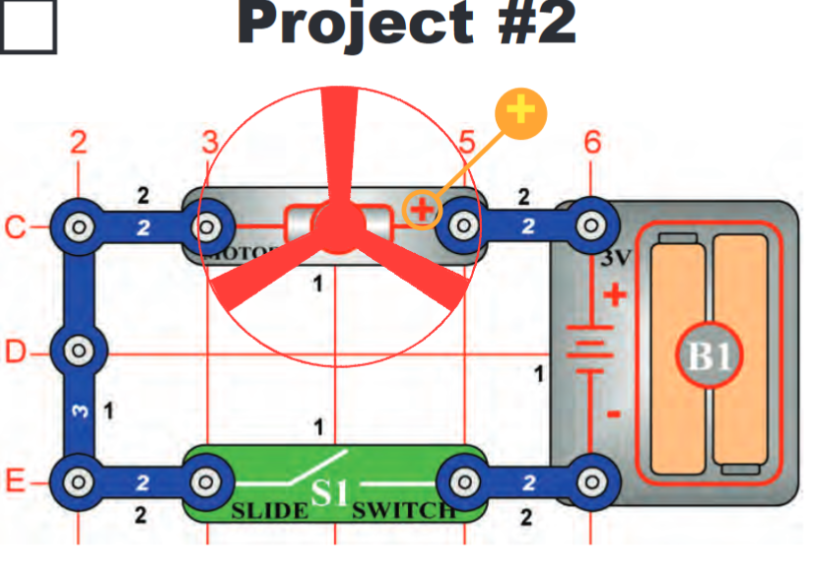
Build projects answering the questions
before continuing

Slide 18
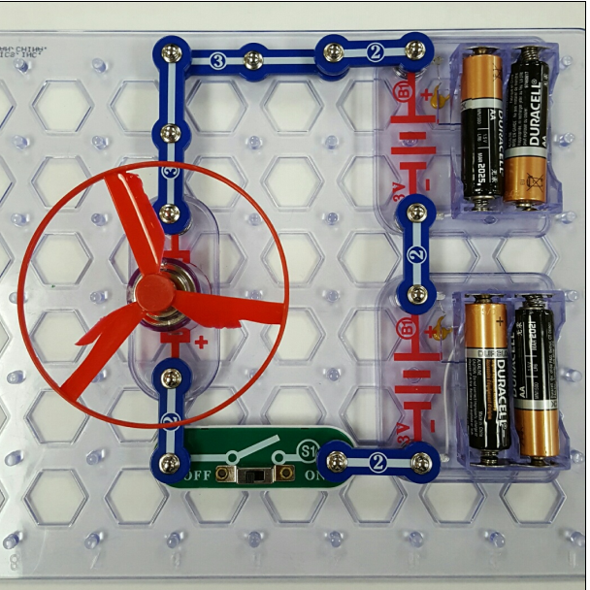
Project 11 & extension:
Add another battery
pack in series
BE SURE
The “+” sign on the motor
is closest to the “–”
(negative terminal)
of the battery.
.

Slide 19
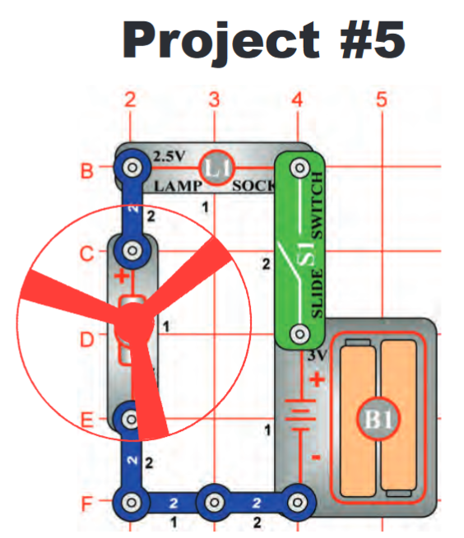
Fan and Lamp
Wired in Series

Slide 20
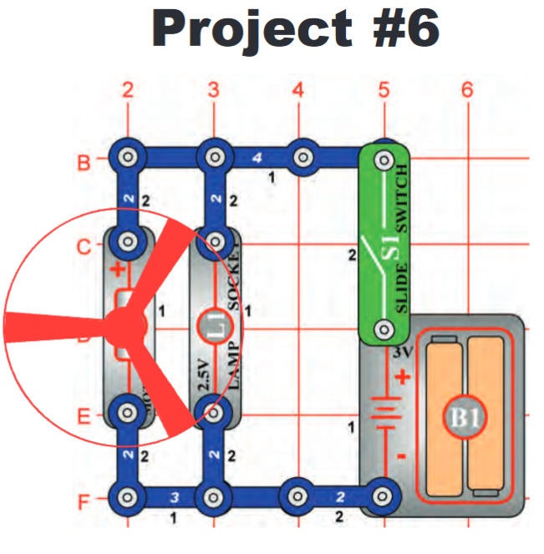
Fan and Lamp
In Parallel

Slide 21
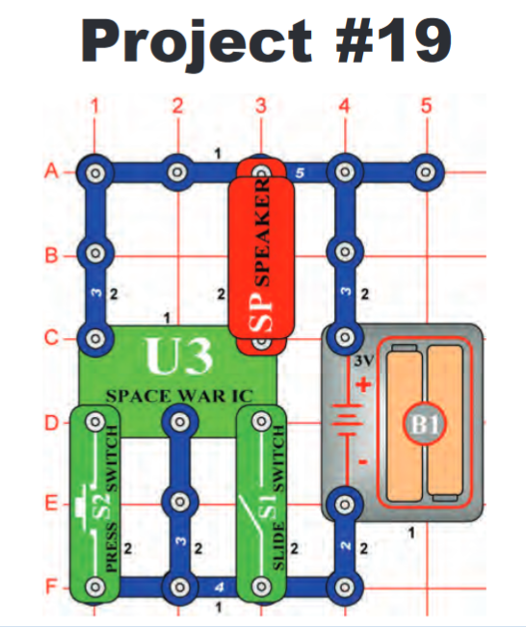
Activity 19 uses a combination of parallel and series circuits with two switches and the introduction of an integrated circuit.

Slide 22
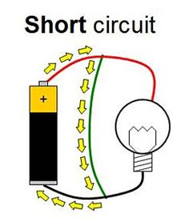
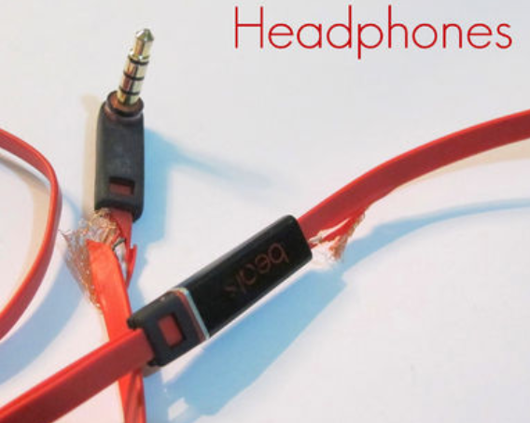
Short Circuits
A short circuit occurs when there is a no resistance path across the batteries.
In electrical devices unintentional
short circuits are usually caused
when a wire's insulation breaks
down, allowing charge to flow
along a different path than the
one intended.

Slide 23
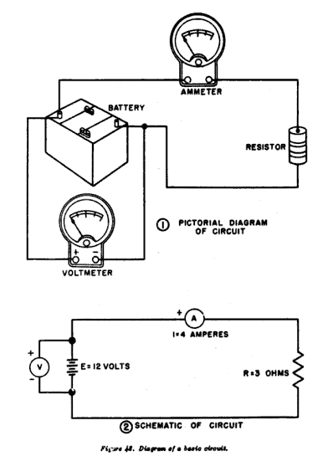
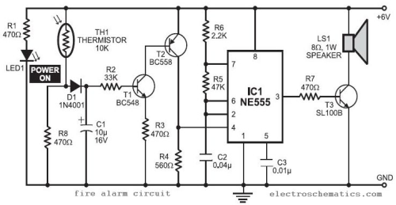
Design Challenge Schematics
Simple
More Complex

Slide 24
Lesson 2 Introduction to Resistance
Resistance refers to electrical friction or resistance to flow between
the electric current and the material it is flowing through.
Resistance limits and controls the flow of electricity.
Resistance in a circuit can vary with:
the length of the wire
the thickness of the wire
the metal used to make the wire.
Resistors are devices that are also known as loads
and have a set or variable resistance.

Slide 25
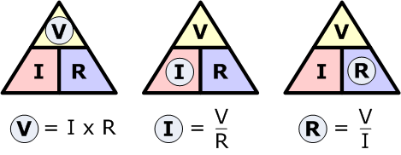
Ohm’s Law
Resistance is measured in Ohms - Ω

Slide 26
Multiple resistors can be included in a circuit in series or parallel.
If a circuit has several resistors in series,
find the total resistance by adding
the resistance for each resistor.

Slide 27
Multiple resistors in a series circuit.
The resistors serves as a “voltage dividing network”
because the current stays the same across the circuit.
The voltage is divided by the resistors.
Each resistor increases the total resistance in the circuit.

Slide 28
Multiple resistors in a parallel circuit
In a parallel circuit, the voltage across each resistor
(and each branch of the circuit) is the same value,
but the current (amperage) is divided.
When resistors are used in parallel, they become a
“current dividing network.” Each path reduces resistance. Think multiple lanes in a highway.
The current flowing through each resistor is only part of the
total current in the circuit.

Slide 29
Multiple resistors can be included in a circuit in parallel.
To find total resistance R_{T} across the circuit
¹/_{RT} = ¹/_{R1} + ¹/_{R2} + ¹/_{R3} + ...
For example, a circuit has two resistors in parallel,
each with 4Ω resistance.
¹/_{RT} = ¹/4Ω + ¹/4Ω → ¹/_{RT} = ¹/2Ω → R_{T} = 2Ω.
In other words, two branches of equal resistance are
exactly twice as easy to get through as one
branch alone.

Slide 30
Lesson 2 Introduction to Resistance
Types of resistors in Snap Circuits
1 KΩ Resistor
5.1 KΩ Resistor
10 KΩ Resistor
100 KΩ Resistor
1 100 Ω Resistor
Variable Resistor
Photoresistor

Slide 31
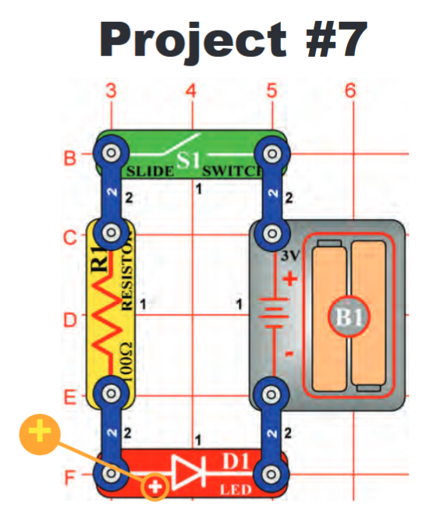
Note: In order to answer all the
Questions about this project, students
must first read background information
and terms.

Slide 32
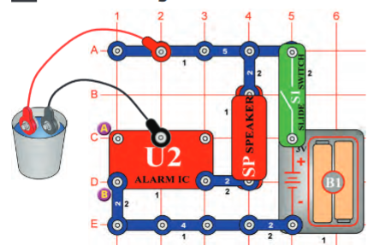
Complete
Projects 98 - Water Alarms
For Project 99
Add salt to water

Slide 33
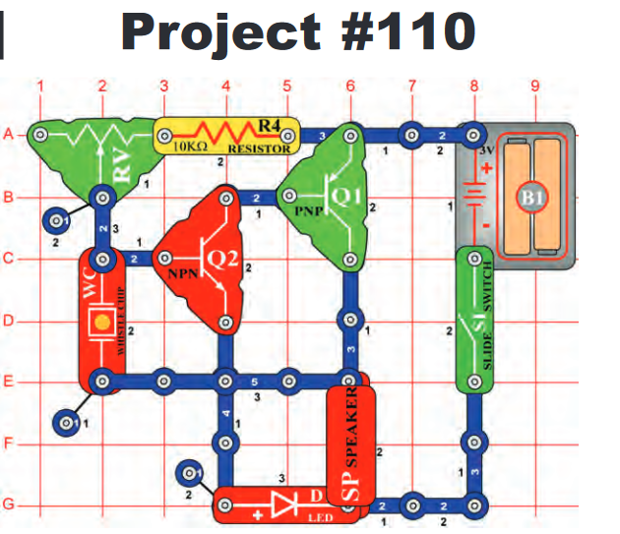
Adjustable Tone Generator
Just as a faucet controls the
Amount of water that comes out of your pipe, a variable or adjustable resistor controls the
flow of electrons in a circuit.

Slide 34
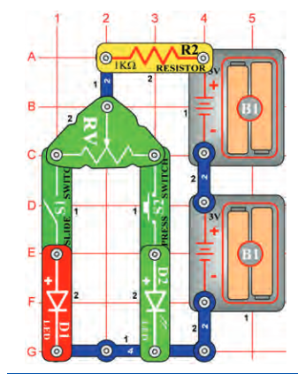
Project 172 –
Red and Green Control
More variable resistors

Slide 35
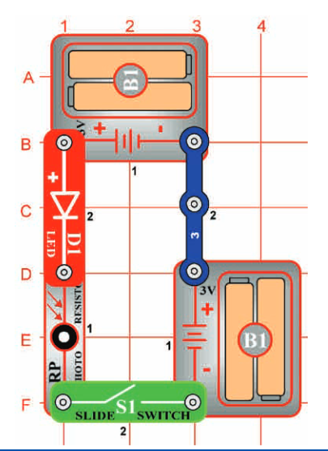
Some materials change their resistance
when light shines on them.
These light sensitive materials, such as
Cadmium Sulfide are classified as
photoresistors.
Resistance increases as the light
becomes brighter.

Slide 36
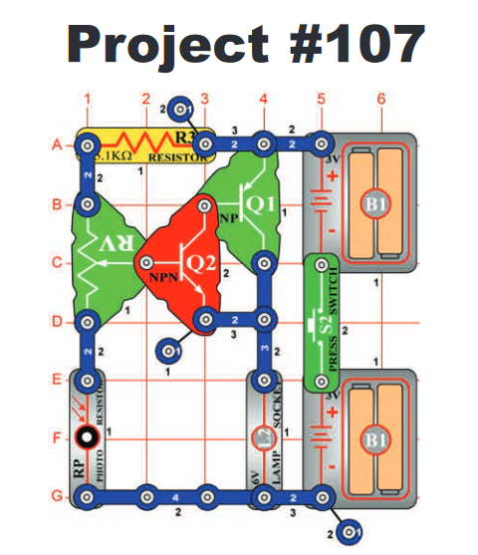
This project has multiple
resistors including:
5.1K Ω
Variable resistor
Photoresistor
It also uses a transistor.
These can be considered
a current amplifiers.

Slide 37
Optional Projects with Resistance

Slide 38
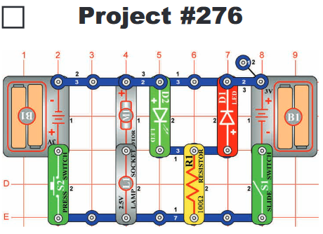
Two sets of batteries will
drive the fan in opposite
directions.
The lit LED indicates the
direction.
Turning on both switches
Causes a short circuit.

Slide 39
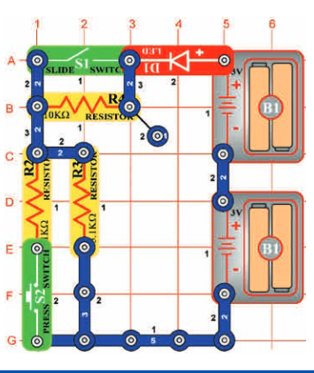
Projects 173 – Current controllers
Resistors in parallel and
series circuits.
Changing the switch, changes the path for the electrons.

Slide 40
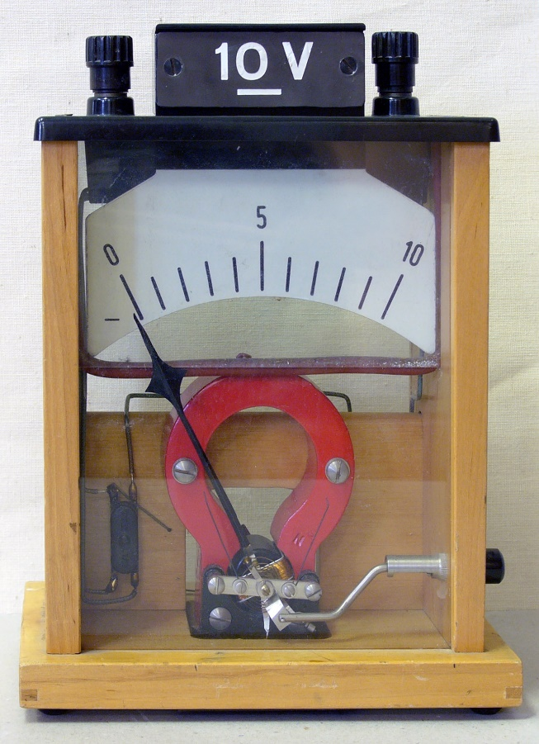
Lesson 3 Meters
Inside a meter is a fixed magnet within a movable coil.
As current flows through the coil, it creates a magnetic field.
The interaction between the two
magnetic fields causes the pointer
on the meter to move.

Slide 41
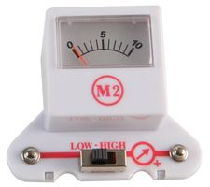
Remember the relationship
As current increased, resistance decreases.
As current decreases, resistance increases.
Inverse relationship.
The snap circuit meter measures current
in a series circuit and voltage in parallel.

Slide 42
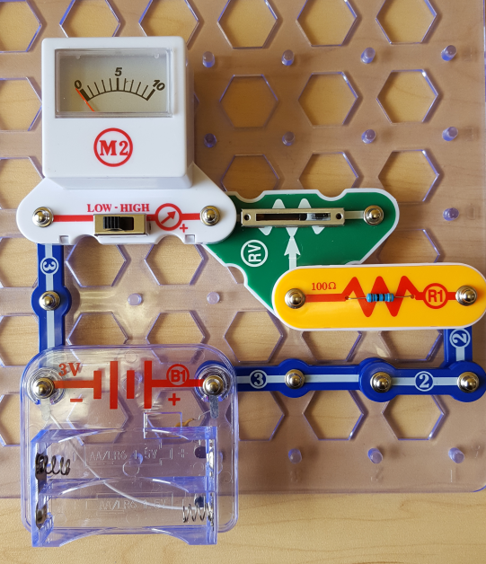
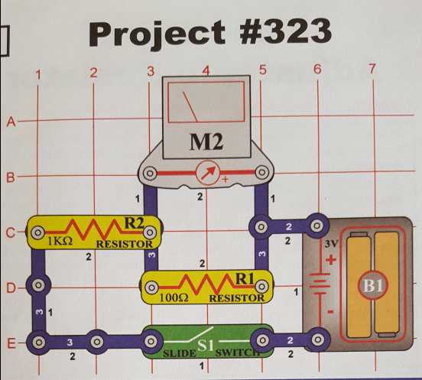
Lesson 3 Meters
Activity 1
Project 324 0-3 Voltmeter
Project 323 – 3mA (milliamp) Meter

Slide 43
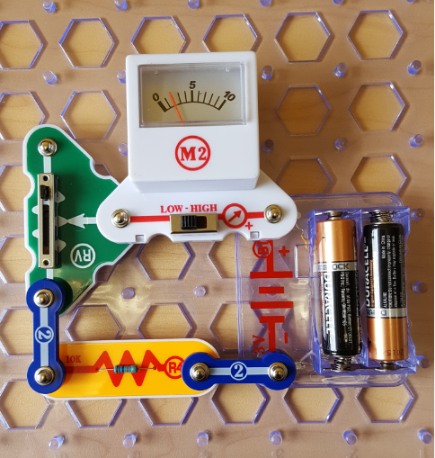
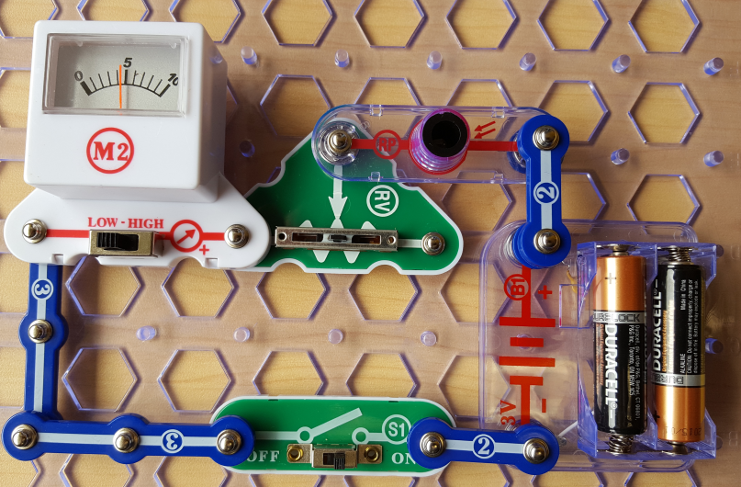
Activity 2:
Project 325
Function of Adjustable Resistor
Project 486
Simple Illumination Meter

Slide 44
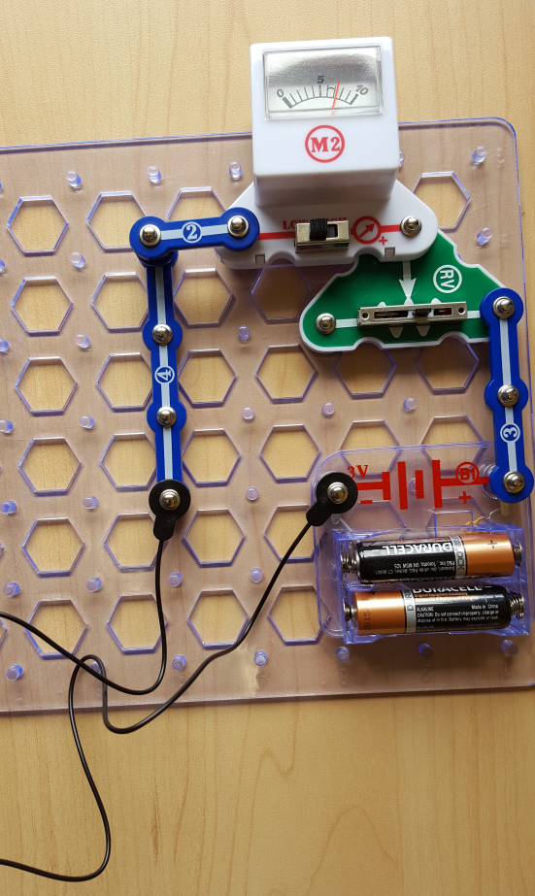
Activity 3: Project 494 – Measuring the Resistance of Different Loads

Slide 45
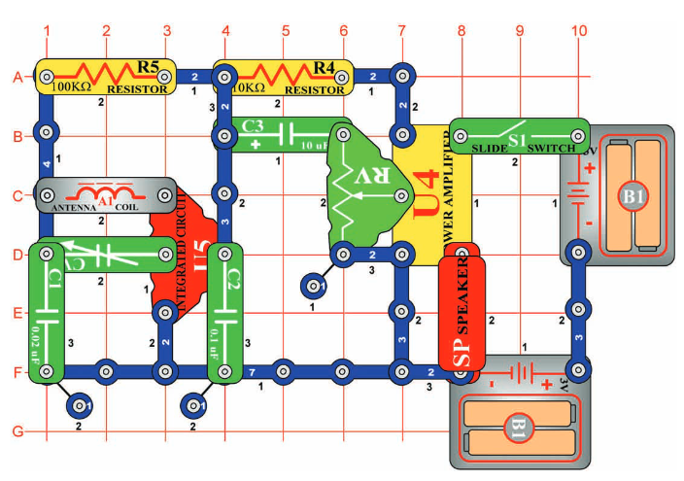
Extension Activities
Continued electricity topics that may be explored
with Snap Circuits include:
Capacitors
Transistors
Generators
More Integrated Circuits
Activity 242 builds an AM radio

