Slide 1
Orrville Utilities Jeff Brediger, Director of Utilities
Notes:
2019 Presentation to Ohio Energy Project meeting hosted at Orrville Utilities Water Plant (3rd year).
Appointed Director in August 2009. I have been with Orrville Utilities for 32 years and in the utility sector for over 37 years.

Slide 2
Public Utility Board
Board Members -Michele Abel (Pickett Tax & Investment), President -Russell Miller (JM Smucker), Vice President -Don McFarlin (Moog-Flo Tork) -Steve Combs (Rable Machine, Mansfield) -Paul Vance (Mennonite Mutual Insurance)
Meetings every second & fourth Monday at 6:30PM in City Hall
Notes:
Let’s begin will a little background.
The Public Utility Board, by City Charter, is responsible for operation & maintenance, improvement or expansion and the establishment of rates for the Electric, Water & Wastewater Utilities. Board members are appointed by the Mayor.
The Board appoints the Director of Utilities who manages the Electric, Water & Wastewater Utilities. The Board provides independent oversight & control which eliminates politics from the picture.
All utilities are non-profit and have their own enterprise funds (i.e. rates are set separately to ensure each Utility is independent & financially sound). This financial separation also keeps politics at arms length to allow the utility to operate more like a business that is still controlled locally.
There is no formal subsidizing between the Utilities or City. By ordinance, however, the City receives free electric for the buildings & street lighting as long as it remains economically feasible.
In addition, the Utility operates 65 miles of fiber optic communication systems & provides City-wide computer systems and network support.
All Utility plants are relicensed (operating permits renewed) every 5 years. Generally the EPA imposes additional limits & operating restrictions with each renewal.

Slide 3
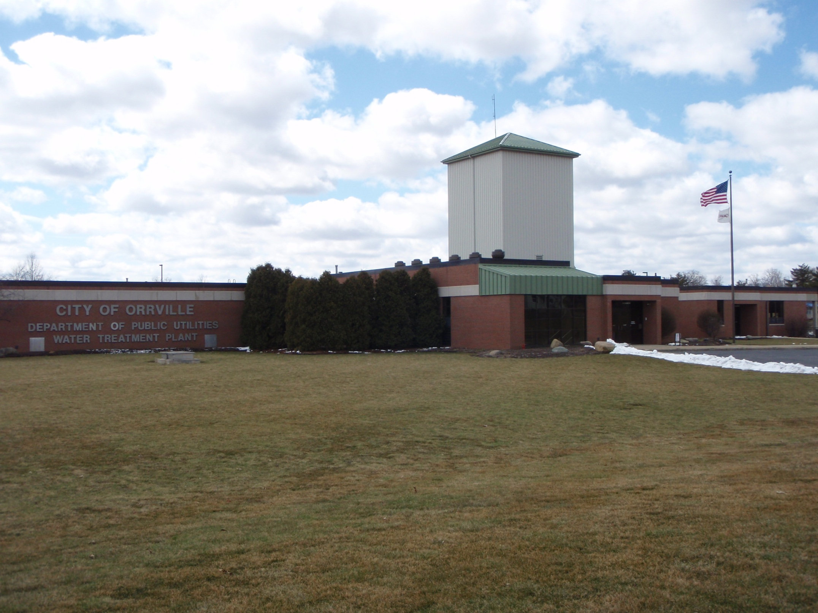
Notes:
Water Utility.
Raw water from underground wells is pumped to the Water Plant then proceeds to lime softening, stabilization, re-carbonation, filtration, fluoridation and chlorination processes before coming to your faucet.
Fluoridation started in 1958. Once started, we can not stop per EPA regulations.

Slide 4
Orrville Water Plant Todd Fetty, Superintendent
Oldest Utility, established in 1894
New Water Treatment Plant constructed in 1997 with an EPA approved capacity of 3.7 MGD, cost $13M
In 2009, received EPA approval for an increased capacity of 6.0 MGD
Treated an average of 1.9 million gallons per day
Operating budget, $2.4M
Notes:
The first utility. The City was incorporated in 1864.
The Water Plant is designed to supply 100% of the water requirements to the Power Plant and land leases are in place for future wells.

Slide 5
Supply & Distribution System
11 wells
61 miles of water lines (sizes 4” – 16”)
2 booster pump stations
3 elevated towers (West & South 150,000 gallons, Central 275,000 gallons)
2 underground tanks (1M gallon capacity each)
1 clear well tank (800,000 gallon capacity)
3,700 customers
950 valves
450 fire hydrants
Notes:
Central (downtown) tower built in 1938, West & South towers built in 1973.
North 1M gallon underground tank built in1974, South 1M gallon underground tank built in 1986 located at west tower site.
Can store enough for about 2 days (at 2M/day).

Slide 6
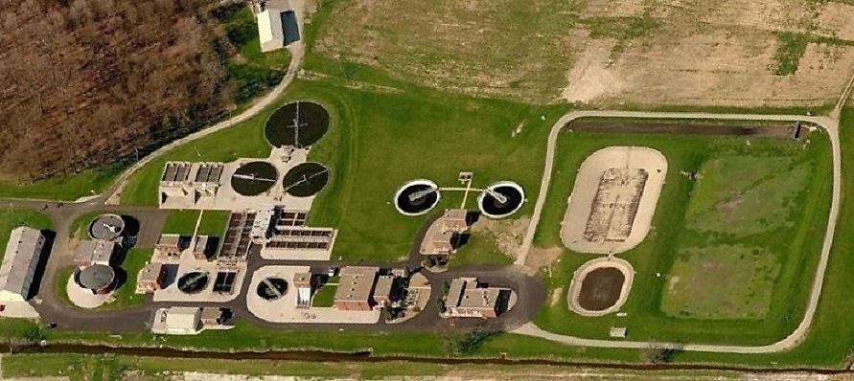
Aerial View of Plant
2MW Solar site located south of creek
Notes:
Wastewater Utility site.
One of the two new solar sites is located south of the plant (across the creek) .

Slide 7
Orrville Wastewater Plant Bob Auten, Superintendent
Established in 1908
Current facility constructed in 1951
Major expansions in 1969 and 1989
2.1 Million Gallons Average Flow per day
7.1 Million Gallons Maximum Flow per day
42 Miles of sewer lines, 8-42”
Treated over 800M gallons of wastewater
Operating budget, $2.3M (Capital projects $280k)
Notes:
This facility handles the most complex and dynamic processes of all three utilities.
We manage seven industrial pretreatment programs-Orrville must (required by law) enforce federal, state and local industry specific discharge limits and rules for the EPA.

Slide 8
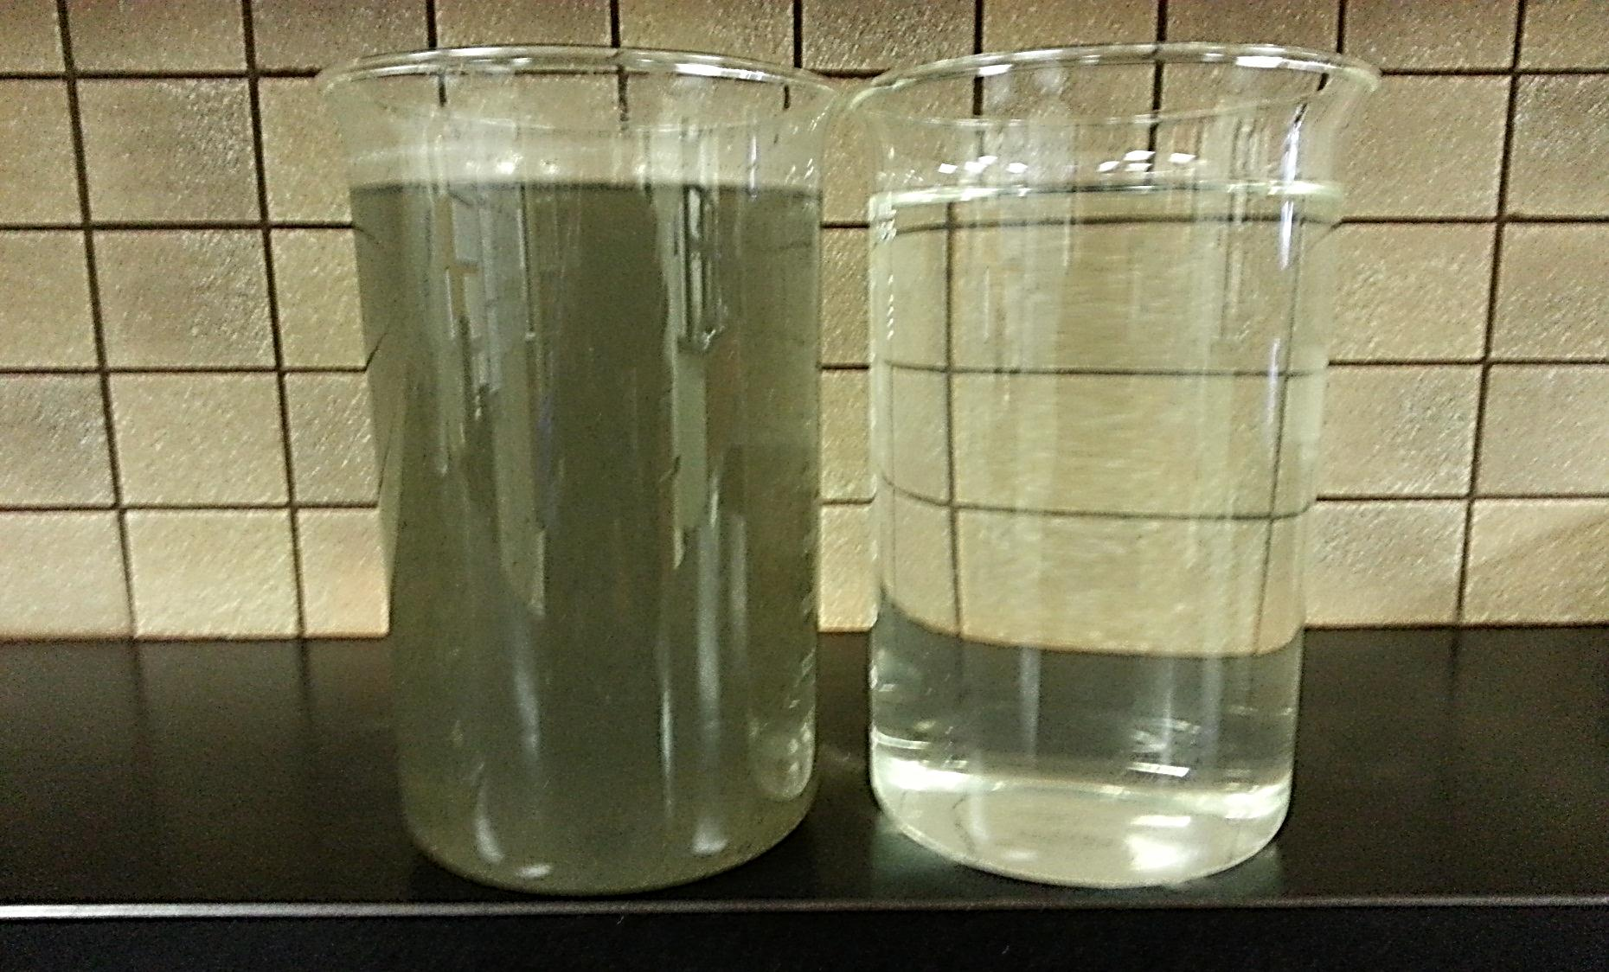
Influent Effluent
Notes:
Typically the way ‘it’ comes into the facility for processing after we pre-screen & grind it up.
The water (effluent) discharged into the creek is typically better (higher quality) than what’s normally flowing in it.

Slide 9
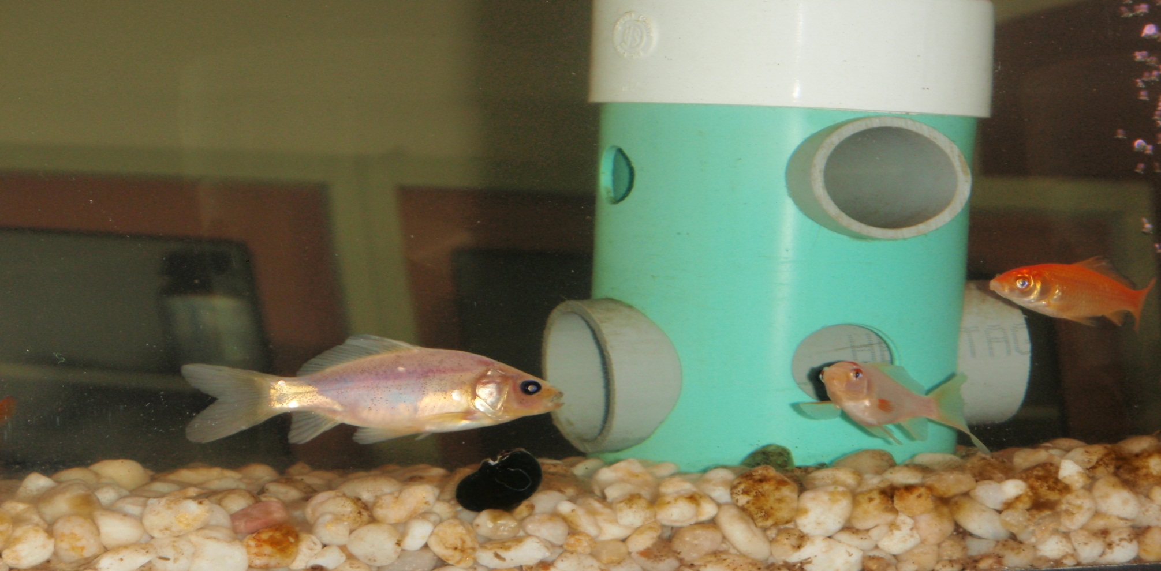
In-Line Fish Tanks, periodic bio-assays (using aquatic life), chemical and physical testing is used to confirm effluent quality to meet or exceed EPA standards before discharging to the creek.
Notes:
In addition to lab tests, we also monitor daphnia (called water fleas which are small aquatic planktonic crustaceans) which are even more sensitive to water quality.
The final effluent also flows thru this tank and a pond in front of the office entrance.

Slide 10
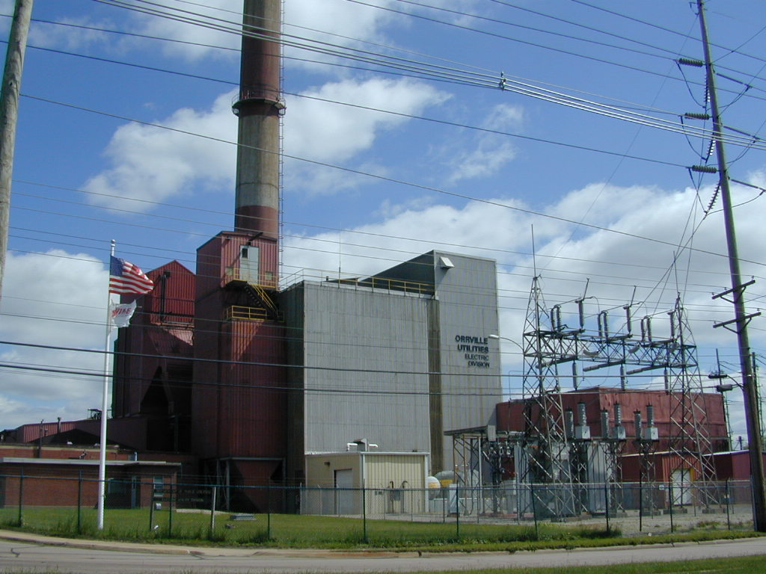
Notes:
Electric Utility (the youngest utility at a little over 100 years old).

Slide 11
Orrville Generating Plant
Established 1917
Four coal-fired steam generators providing steam to 3 turbine-generators. Total capacity, 63,000kW.
Last unit installed in 1969
Coal units are now restricted to 10% capacity. Unlimited operation on gas converted unit.
7,385 customers
Operating Budget, $33.5M (Capital projects, $1.9M)
Burned 9,240 tons coal & 247,300MCF gas to generate ~9% of energy needs
Notes:
Orrville is only 1 of 3 communities (Dover, Painesville is peaking only) in Ohio that generate their own electricity (at one time there were around 90). Others shut down due to age, lower rates offered by investor-owned utilities,, cost & regulations.
We also own our distribution system (poles & wires) and 8-mile transmission line to an AEP substation were we’re connected to the national electric grid.
Power Plant net generating capacity ~58MW. Three steam-turbine generator units (one 22MW and two 25MW). Unit 9 (22MW) installed in1963, Units 10 & 11 (25MW each) installed in 1969 (these are the original units from Dept. of Defense’s Oak Ridge, TN plant which was part of the Manhattan Project, the atomic bomb development program, originally installed in 1941.
The oldest boiler (steam generator) was installed in 1951 (Boiler10), 1957 (Boiler 11), 1963 (Boiler 12), 1969 (Boiler 13).
Coal cost $864k, gas $1.2M ($1.4M for 19,450 tons & $2.57M for 558,900MCF gas, provided 21% of energy needs in 2017).

Slide 12
Electric Department Dean Kallenborn, Electric Utility Manager Dick Smith, Distribution Superintendent
Sold 308,916,000kWhs in retail sales (up 2.5%, plant generated about 9%, ~57% lower than 2017)
Peak demand, 62,920KW, June 18th , 2PM
Retail sales, $31.2M
Wholesale sales, $2M
298 pole miles of distribution lines covering 125 sq. miles
Employees- 20 Power Plant, 11 Distribution, 4 staff
Notes:
Service area covers the eastern 1/3+ of Wayne Co. Some customers in Stark Co.
Dean has been with us 33 yrs. Dick has been with us 37 yrs.
Normal peak period is in late August/early Sept but we have been close the past few winters. All time peak June 18, 2018, 63.1MW.
Generation 57% lower (57% lower in 2017) due to new EPA limits on coal units, new emission limits & higher cost of operation on natural gas converted unit.
Purchase power costs up due to last hydro project coming on line & higher transmissions costs.
Plant personnel down 30% since 2016.

Slide 13
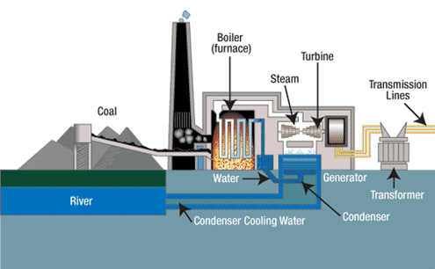
<Pollution Control Equipment
or cooling towers
Notes:
Typical coal-fired generation plant. There is significant pollution control equipment located before the stack (scrubbers, ESP’s, bag filters, mercury control, low NOx burners). Our largest coal-fired unit was converted to natural gas in 2016 (the rest of the process remained the same except the pollution control equipment was not required).
Our plant has electrostatic precipitators on the coal-fired units to remove 99%+ smoke/soot/ash particles and low NOx gas burners. We burned washed coal that has lower impurities and thus emits lower emissions. We utilize cooling towers since we are not located near a river or other large body of water.

Slide 14
Notes:
Once steam is generated by any fuel source, it goes to a steam turbine which drives an electric generator.
Our turbine-generators operate at 3600RPM & produce electricity at 13,800V that is distributed over a network of wires. Your home is 120V.

Slide 15
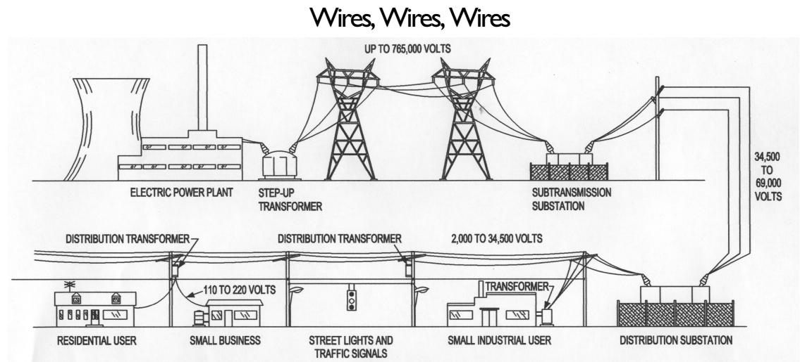
Notes:
Our plant is also connected to the national electric grid at 138,000 volts.

Slide 16
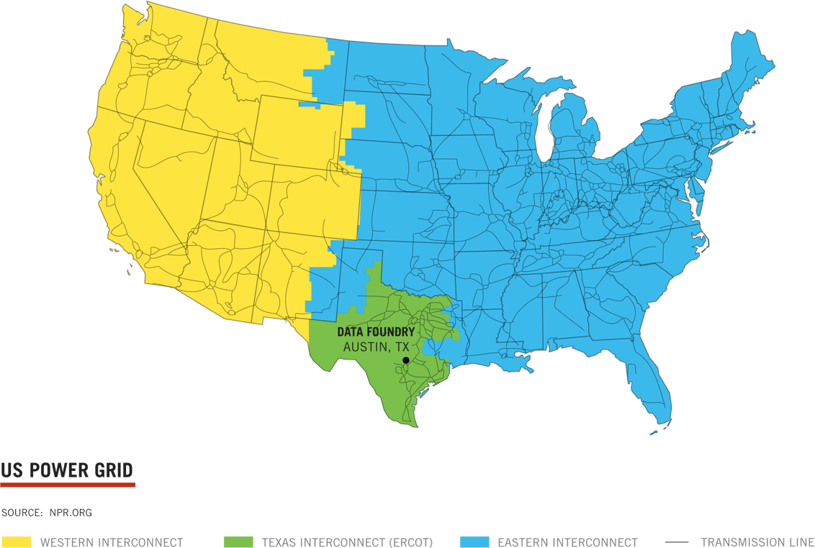
Notes:
Three regions comprised of hundreds of miles of 300,000 to 1,000,000 volt lines.

Slide 17
2016
Notes:
Here are the past 6 years. Charts show the percent of energy from sources to serve our customers. Power Plant is Blue (50/50 coal & gas in 2018). Total renewable sources should be over 21% in 2019! Hydro production was lower last year due to too much rain. The decline in output from the power plant has been a combination of market pressure as well as the most recent EPA mandated operational restrictions which went into effect in 2017.
From Generation Portfolio report.

Slide 18
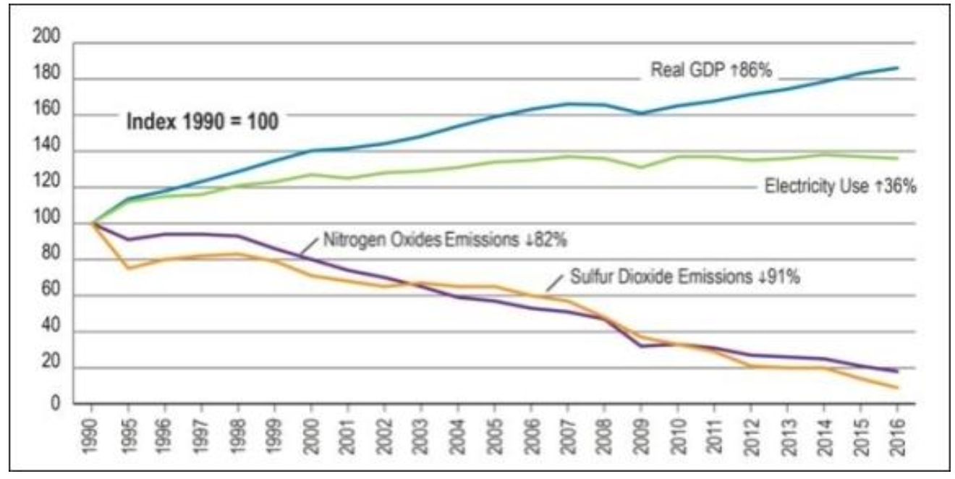
Power Plant Emissions since 2016
SO2 decreased 93%
NOx decreased 92%
Particulates decreased 83%
Notes:
This slide shows a lot of progress for the electric industry and us! Very telling national stat’s. Nation’s energy usage up 36% while still making huge strides in reductions.
Our significant emission reductions were the main driver of EPA settlement. We ended up well below the annual required limits.
SO2=Sulfur dioxides, NOx=Nitrogen oxides, Particulates=Ash, non-combustible particles contained in smoke. Our decreases are mainly due to converting the largest unit to natural gas & limiting the operations of the coal units to 10%
which went into effect January 31, 2017.
Source: Valuing the national investment in coal-based power generation plant air emissions controls report by APPA,EEI,NRECA 2018 report. Plant emissions from EPA FER report.

Slide 19
tons
93% Reduction
Notes:
Our carbon footprint has reduced significantly over the past 10 years. C02 emissions are the primary contributor linked climate change.
Source: 2018 GHG report

Slide 20
Notes:
APPA members (i.e. Public Power Utilities) range 8.37-37.34 (Hawaii)
AEP & FE rates a both about 13 cents/kWh (about 15% higher).
Source: APPA Stats and Facts 2018

Slide 21
Power Supply Sources
NYPA (hydro)
Hydro Phase I & II
Prairie St. (advanced clean coal)
Fremont (natural gas)
Blue Creek Wind
Solar
Wholesale Energy Markets
Power Plant
Notes:
These projects & market purchases allow us to diversify to lower our risk exposure due to environmental & regulatory uncertainty, energy market & fuel volatility as well as positioning ourselves for future challenges at the power plant.
We received about 67% of our energy from the projects in 2018 (61% with the balance coming from market purchases 23.9% and the power plant 8.7% in 2017).
NYPA ( a federal allocation from the New York Power Agency) 7,800MWh’s (84.4% LF and about 2.2% of our total energy) in 2018. We receive a little less than 1MW from this federally allocated project. It’s the least expense of all of our energy sources.
In 2019, we purchased 2-4MW blocks of 7x24 power from CITI (yes the banking folks) which should reduce our market costs $200,000 (see prior slides).

Slide 22
Hydro projects
Notes:
Let’s start with the hydro projects.
These were the largest undertaking of hydro development in the US for decades, 4 plants, 350MW, $3.5B project.
Only 3% of the ~84,000 existing dams in the US produce electricity.
These are views of the Phase I hydro project owned by AMP members developed along the Ohio River on existing locks & dams.
Orrville has 11.7MW. Phase I has79 participants and Phase II has 48 participants.
These projects took 4-5 years to construct and be around for over 80+ years.
High costs in the beginning (due to high capital), low cost energy after debt is retired in 2045 and 2049.
Each site excavated 2.5-4M cubic yards of material at a cost of $40-70M and used over 90,000 cubic yards of concrete for the power house.
Cannelton 88MW, Orrville 2.49MW (Phase I)
Smithland 76MW, Orrville 2.15MW (Phase I)
Willow Island 44MW, Orrville 1.25MW (Phase I)
Meldahl 112MW, Orrville 3.46MW (Phase II)
Greenup 70MW, Orrville 2.25MW (Phase II)
Received 12% of our energy from these projects in 2018.

Slide 23
Notes:
Location of hydro’s are on existing lock & dam systems (operated by the Army Corp. of Engineers) on the Ohio River.
We do not have involvement in the Belleville or Hannibal hydro’s which belong to our other members in our association (AMP). Three other hydro’s are located on the Ohio River belonging to other utilities.
The Ohio River drops 460’ over 980 miles from Pittsburgh to the Mississippi River.

Slide 24
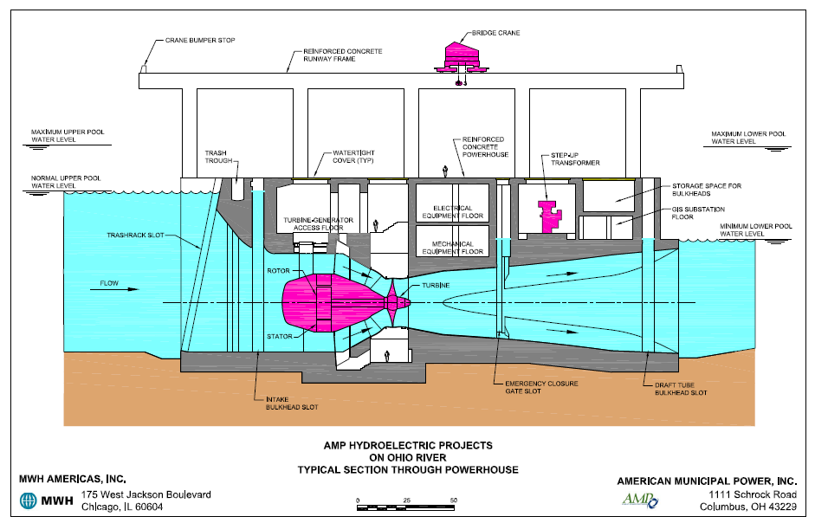
Notes:
Hydro cross section.
The difference in river elevation which ranges from 20-30’ provides the ‘power or head’ to push the water thru the water turbine-generators.

Slide 25
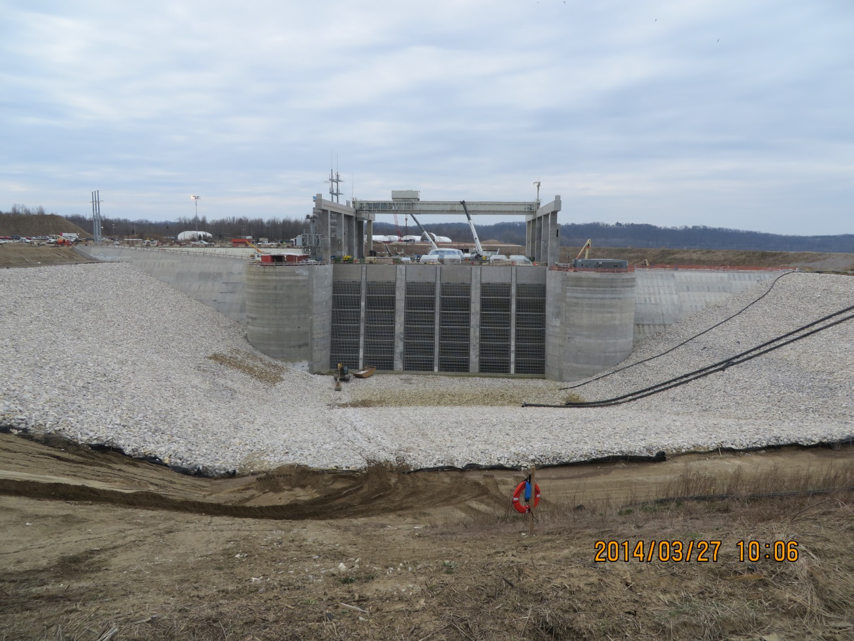
Normal river level
Notes:
Cannelton inlet view before water-up in March 2014.
Most of the plant is under water when in service. Plant is designed to be submerged.

Slide 26
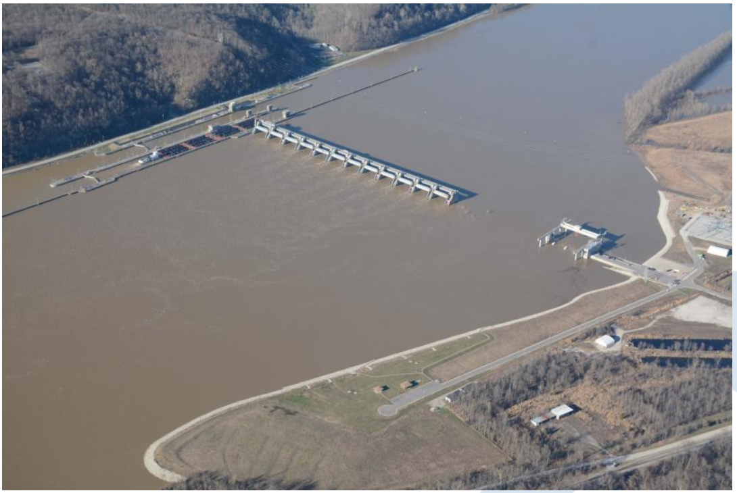
Typical river conditions
High water condition
Notes:
Cannelton hydro project.
Unit 3 commercial operation 1/27/16, Unit 2 commercial operation 3/22/16. Unit 1 in service 6/16/16. Orrville owns 2.49MW of the 88MW plant.
Typical river operating water levels between dams ranges from 10-40’. We work with the Army Corps of Engineers to maximize river pool levels and debris flushing since their focus is river navigation, not generation.

Slide 27
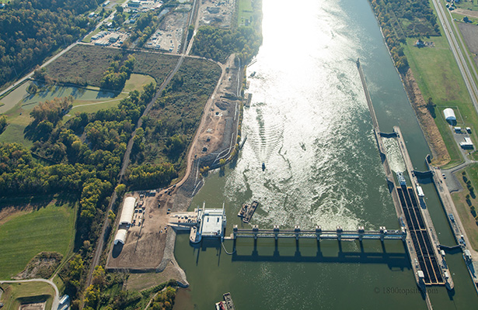
Notes:
Willow Island April 2016.
Hydro electric plant on left, multi-gated dam system in middle, locks on right (note coal barges heading up river).

Slide 28
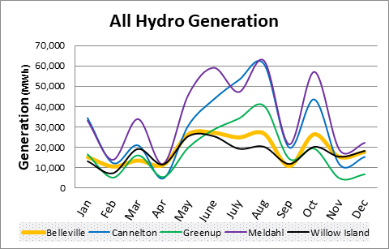
Notes:
Shows output of each hydro site during the year.
Output varies due to rainfall (too much generally or too little), location along the river and Corps control over the river level over the entire length of the Ohio River.
It’s interesting to note that the maximum output of the units is during the summer, high demand time period. This was by design, not accident.
We are not part of the Belleville project.

Slide 29
Prairie State project
Boiler House
Generator Bld.
Pollution control equipment
Cooling towers
Notes:
A $4B, 2 unit, 1600MW state-of-the-art coal-fired plant located in Illinois (25+ times bigger than our power plant).
Over $1B in pollution control equipment. We also own 25+ year coal supply (~$1B) underground, next to plant, a huge benefit.
The coal mine is 200’ underground, 7-9’ coal seam. Provides long term stability on fuel pricing. Plant burns in 1 year what would take us 32 years prior to 2017.
Orrville is one of 68 participants owning a 25% majority share of the project. We have 5MW (provided about 12% of our energy needs). This facility was started up in June 2012.
Efficiency and capacity (output) is higher than originally projected.
A great long-term project utilizing an abundant fuel source.
Received 42,470MWhs or 12% of our energy (97% LF, includes replacement power during outage periods) from this project in 2018.

Slide 30
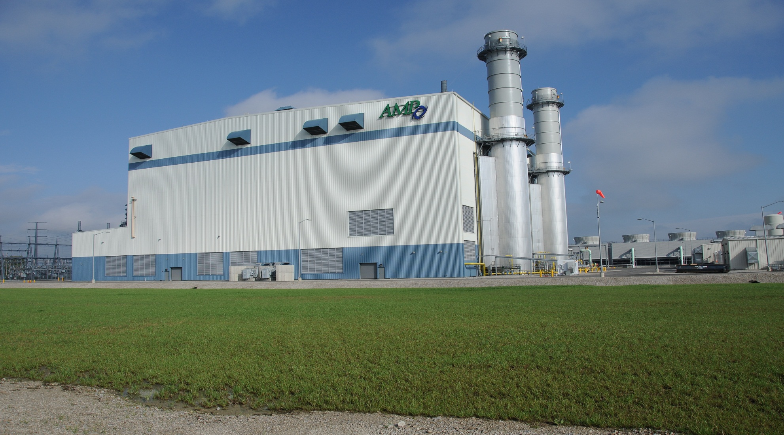
Fremont project
Notes:
A $675M, two unit, 700MW natural gas-fired, combined cycle plant located in Fremont, OH. Orrville has 23.8MW share. Orrville is one of 87 participants.
The plant was started up in January 2012. Natural gas generates half the emissions of a coal plant.
AMP members purchased from FirstEnergy in 2011. Prior to this, the plant was in/out of bankruptcy, until we completed final construction ~10 years after it was first started by Calpine (a merchant builder/owner/operator).
Project continues to exceed expectations.
Received 139,790MWhs or ~39% of our energy (67% Load Factor) from this project in 2018.

Slide 31
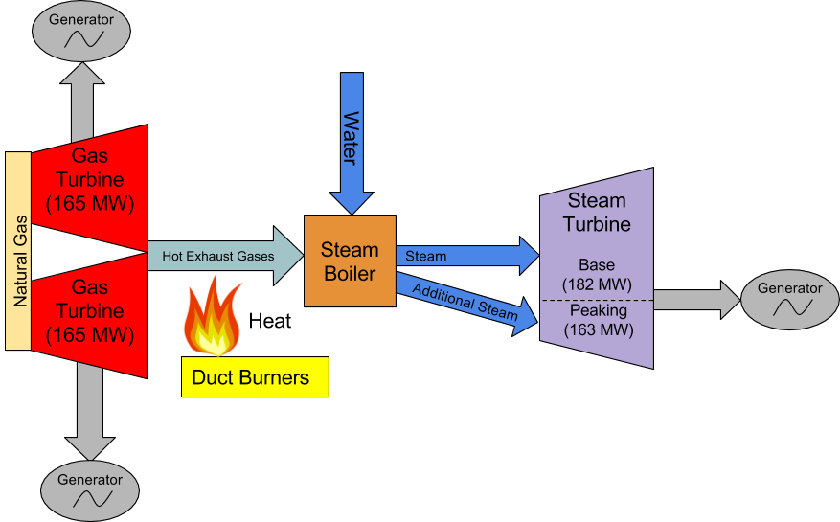
Fremont Energy Center
Notes:
Fremont is a combined-cycle plant (more efficient, higher electrical output) and is typical of most facilities being built today. A gas turbine is just a huge jet engine without wings attached. Hot gas drive the turbine blades vs steam like our plant. A simple cycle gas plant would just include the gas turbines and are generally used for peaking and emergency generation needs.
Duct burners are utilized during peak periods to increase capacity an additional 163MW’s.

Slide 32
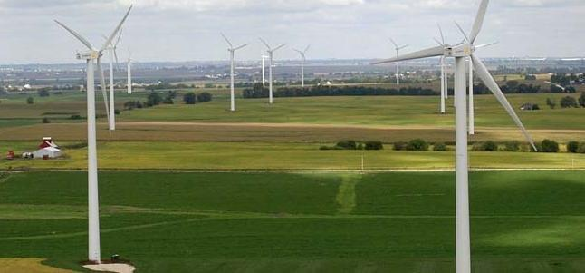
Blue Creek Wind project
Notes:
(152) 2MW Gamesa G90 wind turbines located in Paulding & Van Wert, OH counties (located along SR30, near Ohio/Indiana border). Orrville receives 2MW thru 2022.
We do not own any assets in this project (purchasing energy only via Purchase Power Agreement).
Towers are 328’ tall, blades 110’ long, each unit weighs 85 tons and tracks wind direction & adjusts blade angle to optimize the wind’s energy.
This power supply only contract started delivering energy in June 2012 and was an opportunity for us to purchase energy below actual cost due to weak market prices.
Received 4,860MWhs or 1.4% of our energy (28% Load Factor) from this project in 2018. If we were relying solely on these, the lights would have been out ~70% of the time.

Slide 33
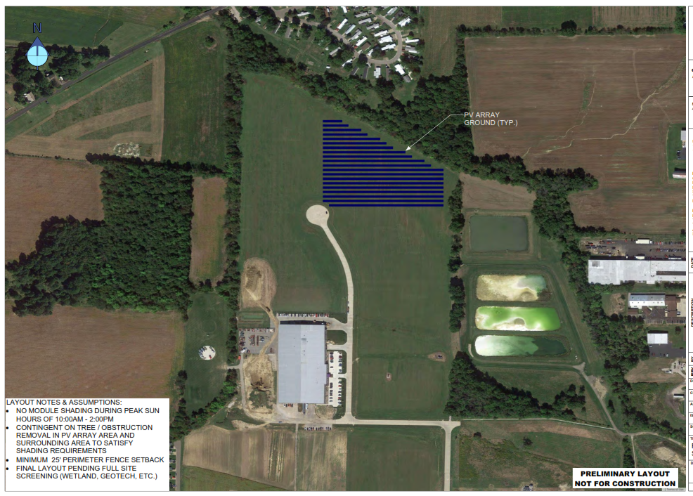
Venture Products
Animal
Supply Co.
Venture
Products
parking
Venture Products
Dairy Lane
Smith Dairy
Orrvilon
Notes:
0.95MW site on 6 acres (~5600 PV modules, original designed for 1.3MW, lowered due to wetland avoidance), ~2400MWh/yr, fixed mounting at 25º )
In commercial operation on January 26, 2018. Property is in a floodplain & wetlands area and was not suitable for building.
Three Water Dept. lime lagoons on right. We do not own these projects (NextEra). Only purchase energy from them for the next 25 years.

Slide 34
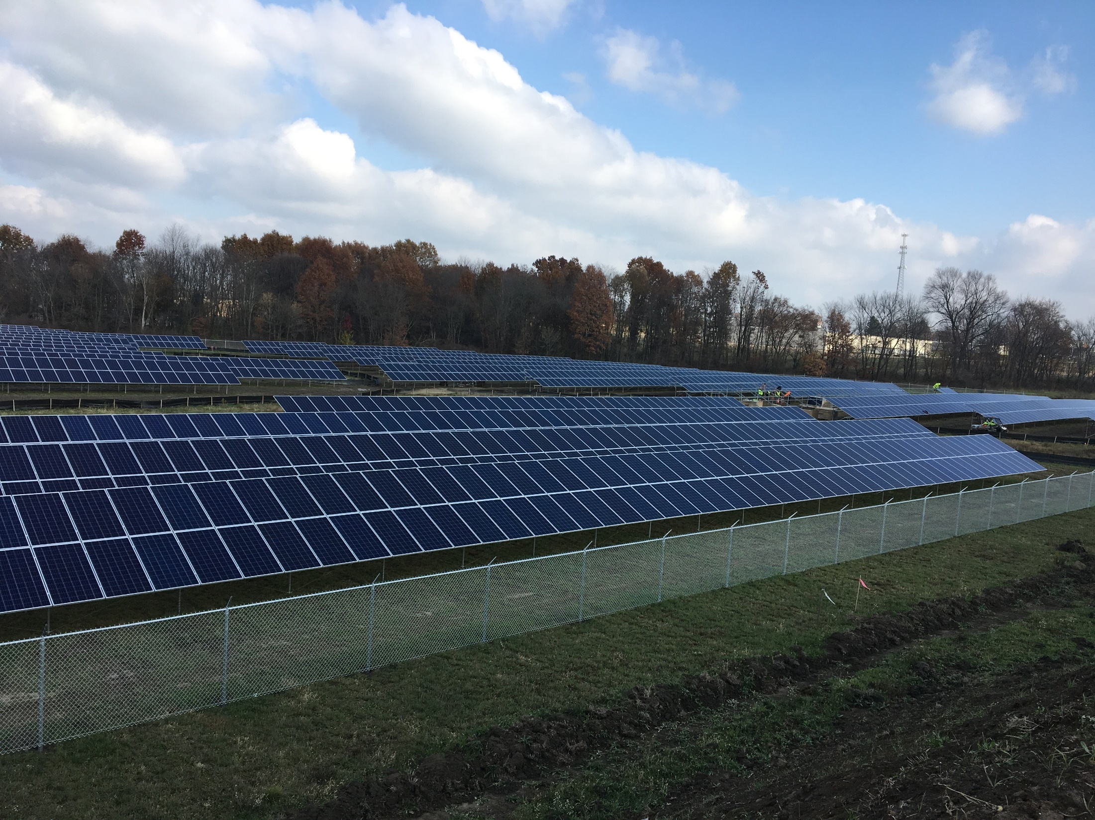
Notes:
This what the site looks like today.

Slide 35
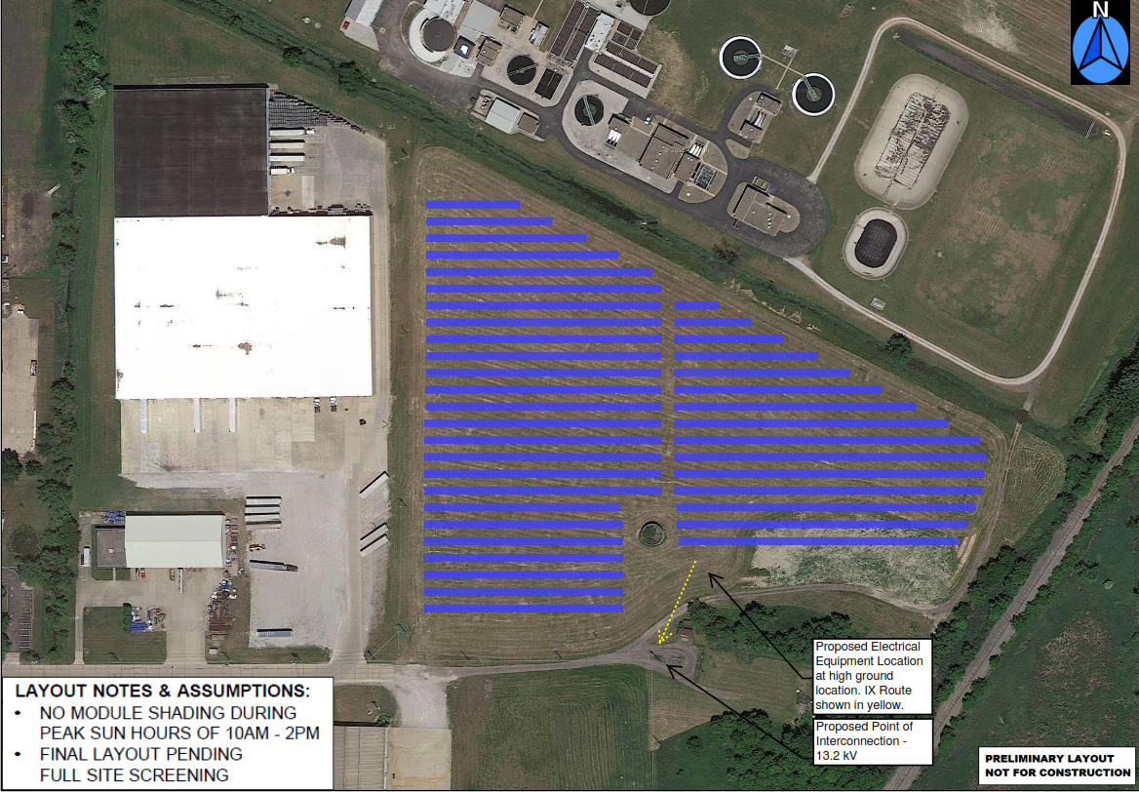
D&S Distributor’s
Warehouse
RTT Route
Railroad
Allen Dr
Notes:
2.25MW site located at end of Allen Dr. 10 acres (~8130 PV modules, ~3600MWh/yr, fixed mounted at 25^{o)}
In commercial operation March 3, 2018. Both sites are fenced in. The concrete tank (in middle) was removed to place additional panels.
The WWTP is to the north. The Rails to Trails route (yellow line) will follow the creek and go between warehouse building to exit on Allen Dr. in late 2017 or early 2018.
Will received 2,430kWh’s or 0.7% (14.7% capacity factor) of our energy from both solar projects in 2018.

Slide 36
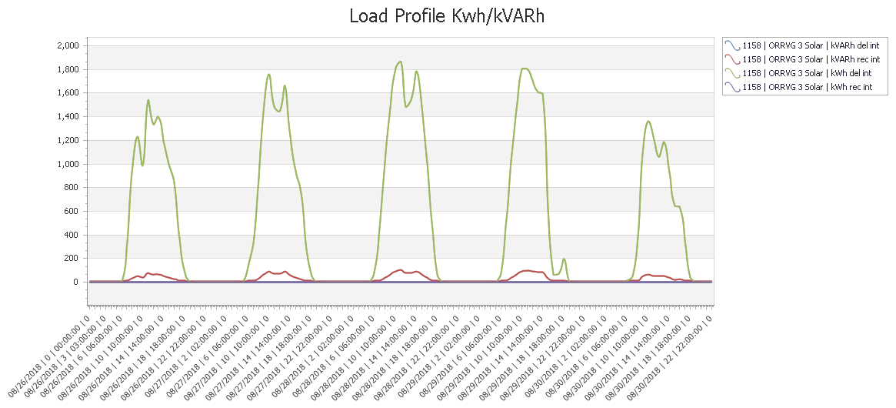
Monday – Friday output from 2MW solar site in August
Notes:
Typical solar output profile for a week at the 2MW site. Primary power output width represents period from 10AM-4PM or about 6 hrs/day.
‘Dips’ are clouds. On Friday, a weather front was moving in so clouds were increasing.
Now all we have to do is to figure out where to get the energy the other 85% of the time!

Slide 37
Notes:
US generation sources. Most additions in 2017 were gas 49%, wind 29%, solar 20%. Coal’s % decreased as expected.
From 2018 America’s Electric Generation capacity 2018 Update report.

Slide 38
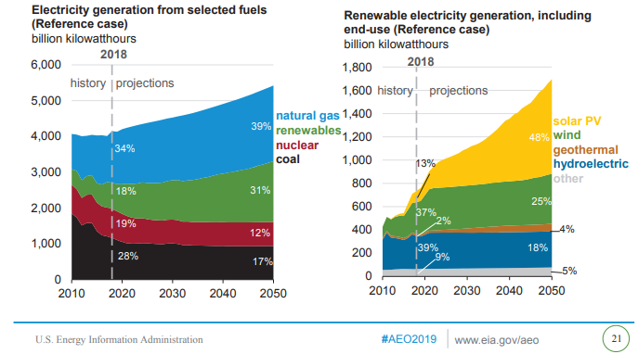
Notes:
Long-term generation forecasts. Bigger increases in solar. Need more development in battery storage.
Source: EIA

Slide 39
Thank You
Visit us at www.orrutilities.com
Questions?
It was our pleasure hosting your meeting. Enjoy the rest of your day.
Notes:
Visit our website for more information.
Thank you.

Slide 40
Extra slides

Slide 41
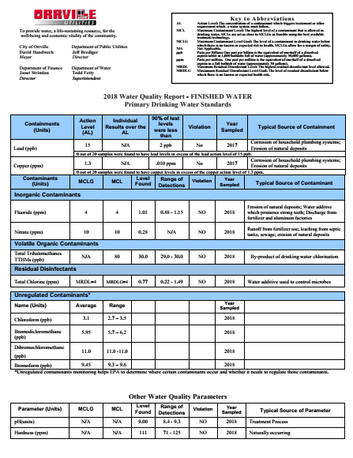
Notes:
2018 Water Quality report. Continued recognition for meeting all EPA standards.
Report is available on our website.

Slide 42
Notes:
A more detailed breakdown of new generation additions thru 2040.
As you can see, most of the new generation is natural gas, followed by wind & solar.
There are a couple of new nukes scheduled but will be offset by a greater number shut downs.

