Slide 1
A Fundraising Approach
Sustaining OEP
October 8, 2020

Slide 2
Today's Presentation
Outline of Discussion
01
What is the plan?
02
What is the role of the Staff?
03
What is the role of the Board?
04
Next Steps

Slide 3
The OEP Approach
Fundraising Plan
With a re-imagined focus on fundraising, OEP will:
Differentiate Funding Sources
Create & Streamline a Partnership Process

Slide 4
Goal - $350,000
Differentiate Funding Sources
Major areas for consideration:
Geography: Local, State, Regional, National
Industry: Energy, Science, Technology, Community Giving Focus
Supporter Types: Organizational, Community Foundations, Government, Individuals
Create & Streamline Partnership Process
Major project areas:
Case for Support
Fundraising Portfolios
Process Manual
Fundraising/Marketing Materials

Slide 5
Staff Roles
Shauni
Jessica
Size: $100,000 +
Geographical Focus: National, Regional, State-wide, Local
Supporter Types: Organizational, Community Foundations, Government
Prospect Amount: 20 - 25
Size: $0 - $99,999
Geographical Focus: State-wide & Local
Supporter Types: Organizational, Community Foundations, Individuals
Prospect Amount: 50 - 75

Slide 6
Staff Goal - $250,000
Process - The Prospecting Pipeline
Identify
Finding companies/grants/individuals that give money
Qualify
Research identified prospects to confirm they give in the same area as OEP expertise
Cultivate
Reach out to contacts at organizations and begin the relationship
Solicit
Ask for a gift to OEP
Steward
Continue to build the relationship through tailored communication

Slide 7
Board Roles
Behind the Scenes
Researching new prospects and investigating current prospects further to identify their area of giving interest.
Making the Connection
Using your network to connect OEP Fundraising Team with potentially interested individuals/organizations.
In the Room
Accompanying OEP Fundraising Team in gift conversations.

Slide 8
Board Goal - $100,000
Process - Options for Involvement
Portfolio Research
Use Shauni & Jessica's portfolios to conduct research, identify potential connections, and identify giving gaps
Prospect Pool Research
Create a bank of prospects for Shauni & Jessica to explore as they move through their portfolios
Foster OEP Awareness
Utilize fundraising tools to spread OEP message and garner interest in community

Slide 9
Portfolio - Sample

Slide 10
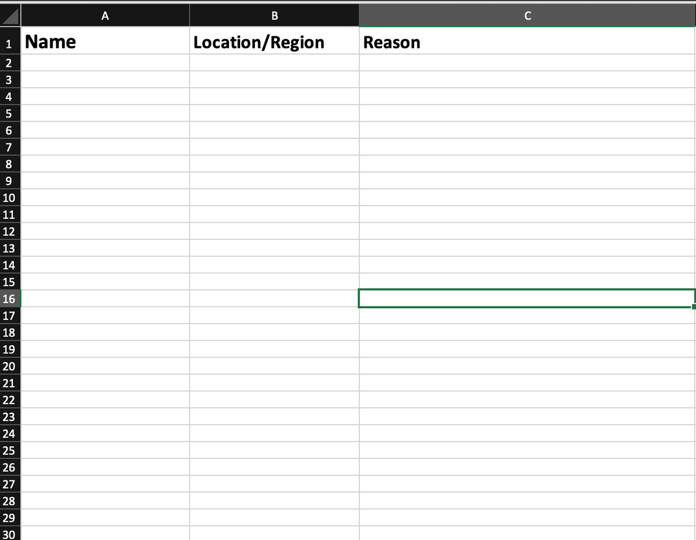
Prospect Pool - Sample

Slide 11
Next Steps
Ahead of Next Time
Expectations
All Board Trustees are asked to participate in some aspect of the fundraising process. Board progress will be logged and reported at each Board meeting.
Role Selection
Following the retreat, you will be contacted to identify which role you would like to take on and will be provided follow up materials from there.
Future Meetings
We will carve out time to discuss fundraising status at all upcoming Board meetings.

