Slide 1
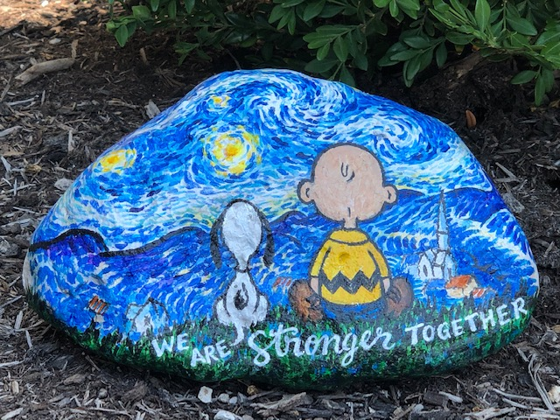
OEP Board & Staff Retreat
October 8th, 2020

Slide 2
Pandemic Progress: the past 6 months
May: Virtual Youth Energy Celebration
Milepost Award – Soar Survey
June: Face to Face across the state with over 150 teachers
Launch of e3 Smart
Battelle Partnership
BIG Give – thank you all!
July: NEW Learning Management System - Canvas
Website Re-development work
Strategic Plan, revised
August: DARE to LEAD Book Club
TVA Partnership
JCI Partnership
New Board members – Keelie Gustin, former OEP student leader, Eliza VanNess
Sept.: Energy Careers Exploration
Wind Design Challenge Development (alternatives to Summits/Workshops)
FACEBOOK
Wrapping up AEP Ohio
Oct: New Fundraising Process at OEP Board Retreat
New Website Launch
Canvas LMS launched with teachers
TEAMWORK. INNOVATION. DARING LEADERSHIP.
OEP Core Values:
Innovative Education
Transformative Leadership
Enduring Relationships

